Slide 1


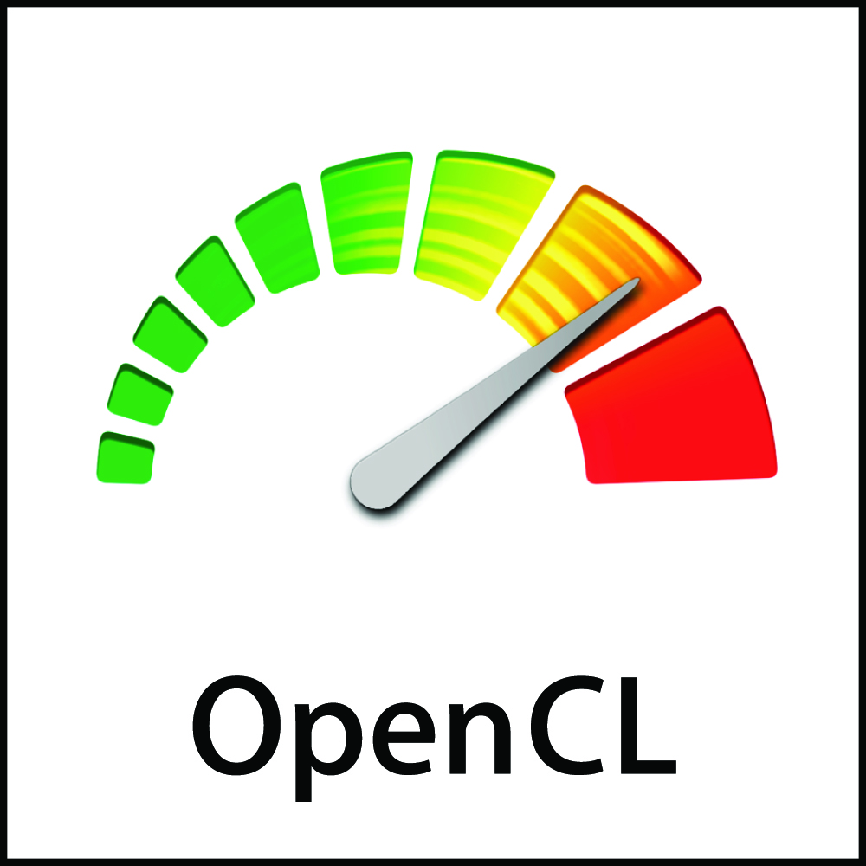


OpenCL and Ecosystem State of the Nation
Neil Trevett | Khronos President
NVIDIA Vice President Developer Ecosystem
OpenCL Working Group Chair
ntrevett@nvidia.com | @neilt3d
Oxford, May 2018

Slide 2

State of the OpenCL Nation
OpenCL is needed by the industry and widely used
Unique framework for portable heterogenous programming
Growing interest in SYCL, SPIR-V and related tools
Significant work in OpenCL 2.2 maintenance release - here at IWOCL!
Focus on Increasing Deployment Flexibility
Enable conformant OpenCL on more diverse processors and platforms
Streamline delivery of OpenCL in safety critical systems
Enable OpenCL code to run on additional run-times
BUT OpenCL Faces Deployment Friction
OpenCL 1.2 remains the widely adopted baseline – slower adoption of 2.X
Vital platforms such as Android do not have official OpenCL
Many embedded processors are locked out from OpenCL conformance

Slide 3
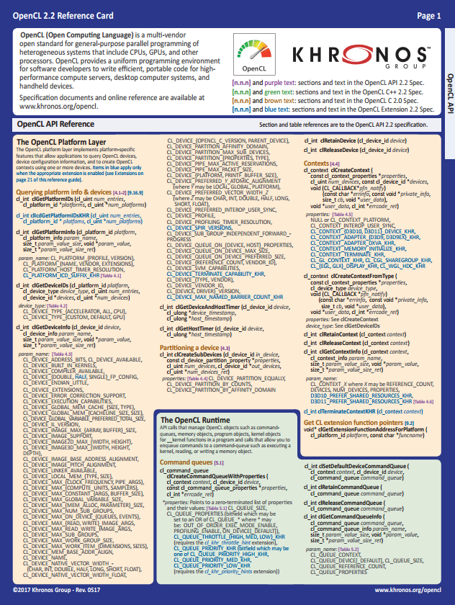
OpenCL Evolution
OpenCL 2.2 Maintenance Release here at IWOCL
2011
2013
2015
2017
OpenCL 1.2
Becomes industry baseline for heterogeneous
parallel computing
OpenCL 2.0
Enables new class of hardware
SVM
Generic Addresses
On-device dispatch
OpenCL 2.1
SPIR-V 1.0
SPIR-V 1.1 in Core
Kernel Language Flexibility
OpenCL 2.2
SPIR-V 1.2
OpenCL C++ Kernel Language
Static subset of C++14
Templates and Lambdas
SPIR-V 1.2 in Core
OpenCL C++ support
Pipes Efficient device-scope communication between kernels
https://www.khronos.org/opencl/

Slide 4

OpenCL 2.2 Maintenance Release
Fully backwards compatible
30+ bug fixes and clarifications
Including public GitHub issue fixes – thank you to those who logged bugs!
Updated and open-sourced the OpenCL C programming language spec
Now possible to make pull requests for it – just like OpenCL API and C++ specs
Same look-and-feel as the other specs
Converted the spec toolchain from AsciiDoc to AsciiDoctor
Same toolchain that is used by many other Khronos specs
Updated specs should be easier to read and to navigate
OpenCL SPIR-V environment specification has been improved
Much easier for SPIR-V generators to know what is legal SPIR-V for OpenCL
Unified headers
Use same headers to target any OpenCL version or to use any OpenCL extension

Slide 5
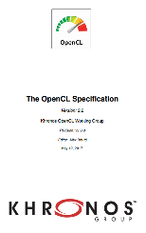
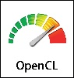
Open Source Specs and Tests
Khronos is open sourcing specification sources, conformance tests, tools
Merge requests welcome from the community (subject to review by OpenCL working group)
Deeper Community Enablement
Mix your own documentation!
Contribute and fix conformance tests
File bugs for specifications, headers, ICD etc.
Contribute new features (carefully)
Source Materials for Specifications and Reference Documentation CONTRIBUTED Under Khronos IP Framework
(you won’t assert patents against conformant implementations, and license copyright for Khronos use)
Spec and Ref Language Source
Redistribution under CC-BY 4.0
Contributions and Distribution under Apache 2.0
Spec Build System and Scripts
Contributions and Distribution under Apache 2.0
Conformance Test Suite Source
Khronos builds and Ratifies Canonical Specification under Khronos IP Framework. No changes or re-hosting allowed
Spec and Ref Language Source and derivative materials. Re-mixable under CC-BY by the industry and community
Khronos Adopters Program
Anyone can test any implementation at any time
Conformant Implementations can use trademark and are covered by Khronos IP Framework
Community built documentation and tools

Slide 6










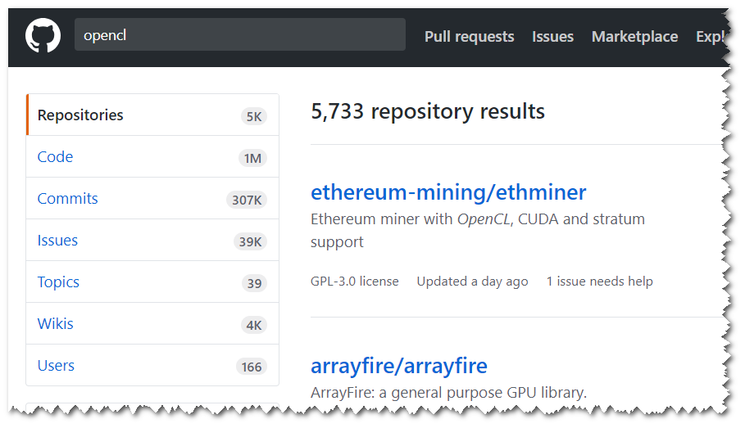
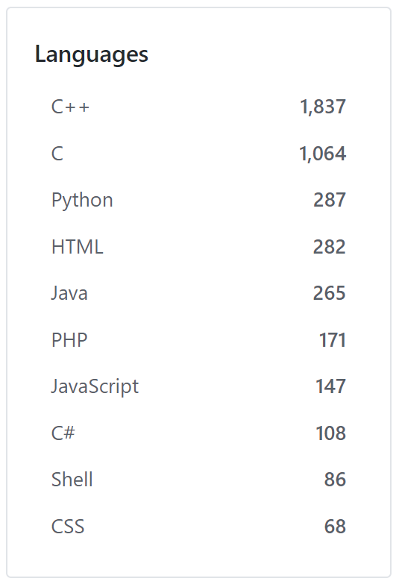



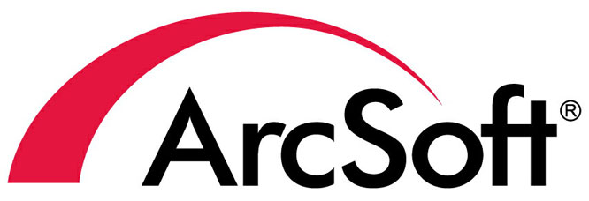

Growing OpenCL Adoption
100s of applications using OpenCL acceleration
Rendering, visualization, video editing, simulation, image processing
Almost 6,000 GitHub repositories using OpenCL
Tools, applications, libraries, languages
Up from 4310 one year ago
Khronos Resource Hub
https://www.khronos.org/opencl/resources/opencl-applications-using-opencl

Slide 7
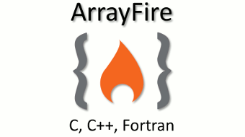





OpenCL as Language/Library Backend
C++ based Neural network framework
Language for image processing and computational photography
Accelerated computing library in open source
Single Source C++ Programming for OpenCL
Java language extensions for parallelism
Vision processing open source project
Compiler directives for Fortran, C and C++
Open source software library for machine learning (beta)
Hundreds of languages, frameworks and projects using OpenCL to access vendor-optimized, heterogeneous compute runtimes

Slide 8




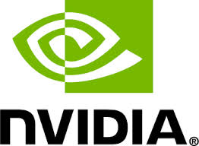







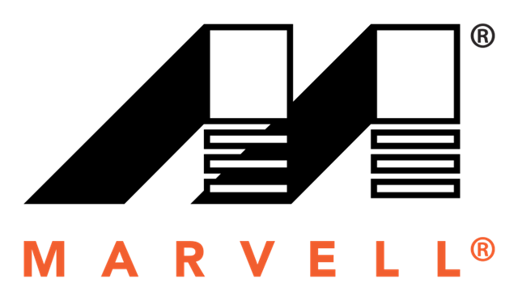


OpenCL Conformant Implementations
1.0|May09
1.1|Jul11
1.2|Jun12
1.0|Aug09
1.1|Aug10
1.2|May12
2.0|Dec14
1.0|May10
1.1|Feb11
Desktop
1.1|Mar11
1.2|Dec12
2.0|Jul14
2.1 | Jun16
1.0|May09
1.1|Jun10
1.2|May15
1.1|Aug12
1.2|Mar16
2.0|Apr17
1.0 | Feb11
1.2|Sep13
Mobile
1.1|Nov12
1.2|Apr14
2.0|Nov15
1.1|Apr12
1.2|Dec14
1.2|Sep14
Adoption Since Last IWOCL
NVIDIA: 1.2 on all current GPUs – Windows and Linux
Qualcomm: 2.0 on Adreno GPUs - Android 8.0
Intel:1.2 on latest processors – Windows 10
1.1|May13
1.0|Jan10
Embedded
1.2|May15
1.2|Aug15
1.0|Jul13
FPGA
1.0|Dec14
Vendor timelines are first conformant submission for each spec generation
Dec08
Jun10
Nov11
Nov13
Nov15
OpenCL 1.0 Specification
OpenCL 1.1 Specification
OpenCL 1.2 Specification
OpenCL 2.0 Specification
OpenCL 2.1 Specification

Slide 9
Understanding OpenCL Adoption Patterns
OpenCL 1.2 remains the widely-supported industry baseline
SVM in 2.0 saps performance in non-unified memory systems – e.g. discrete GPUs
SVM in 2.0 is easier on mobile with shared memory
Some 2.0 features are less ‘controversial’ and shipping more widely than SVM
No OpenCL 2.2 Yet?
12-18 months between spec and first implementations is common
Don’t panic - OpenCL 2.1 implementations are not late yet
SPIR-V front-ends and tools maturing
C++ comes ‘for free’ with SPIR-V 1.2 ingestion
OR
C++ is not interesting to kernel developers?
Single source file apps, SYCL-style, is where the C++ interest is?
Only High-end DSPs
Smaller DSPs do not have 32-bit FP – mandated for conformance
E.g. optimized vision and inferencing engines are ‘locked out’

Slide 10


SPIR-V Transforms the Language Ecosystem
First multi-API, intermediate language for parallel compute and graphics
Natively represents structures in shader and kernel languages
https://www.khronos.org/registry/spir-v/papers/WhitePaper.pdf
Compiler IR for OpenCL, Vulkan and OpenGL
Easy to parse - just a stream of words
Easy to transform – e.g. designed to be easy to convert to and from LLVM IR
Easy to manipulate and optimize - Static Single Assignment form
Diverse Languages and Frameworks
Multiple Developer Advantages
Use same front-end compiler for all platforms
Ship SPIR-V – not shader source code
Simpler and more reliable drivers
Reduces runtime kernel compilation time
Standard
Portable
Intermediate
Representation
Tools for analysis and optimization
Hardware runtimes on multiple architectures

Slide 11
Evolution of SPIR Family
 | SPIR 1.2 | SPIR 2.0 | SPIR-V 1.X
LLVM Interaction | Uses LLVM 3.2 | Uses LLVM 3.4 | 100% Khronos defined Round-trip lossless conversion
Compute Constructs | Metadata/Intrinsics | Metadata/Intrinsics | Native
Graphics Constructs | No | No | Native
Supported Language Feature Sets | OpenCL C 1.2 | OpenCL C 1.2 OpenCL C 2.0 | OpenCL C 1.2 / 2.X OpenCL C++ GLSL HLSL
OpenCL Ingestion | OpenCL 1.2 Extension | OpenCL 2.0 Extension | OpenCL 2.1/2.2 Core
Graphics API Ingestion | - | - | Vulkan and OpenGL 4.6 Core
SPIR-V defines supported subsets for each ‘host’ API through ‘environment specs’

Slide 12

Support for Both SPIR-V and LLVM
LLVM is an open source SDK, not a formally defined standard
Khronos moved away from trying to use LLVM IR as a standard
Issues with versioning, metadata, etc.
But LLVM is a treasure chest of useful transforms
SPIR-V tools can use encapsulation and use LLVM to do useful SPIR-V transforms
SPIR-V tools can all use different rules – and there will be lots of these
May be lossy and only support SPIR-V subsets
Internal form is not standardized
May hide LLVM version, metadata
GLSL
OpenCL C
HLSL
OpenCL C++
SPIR-V
Transform Tool
- Compression
- Optimization
- Stripping
Linker/Merger
‘Rendezvous’ format for interchange
Native expression of graphics and parallel functionality for Khronos APIs
Tool-encapsulated LLVM
Driver

Slide 13
New OpenCL Tooling Ecosystem Subgroup
Coordinating collaborative opportunities between SPIR-V and LLVM ecosystems
Encouraging joint development of new features and tooling integration
New common SPIRV<->LLVM translator repo w/o using LLVM tree
Extending SPIRV<->LLVM translation for OpenCL, and for Vulkan over time
https://github.com/KhronosGroup/SPIRV-LLVM-Translator
Support SPIR-V as supported Clang Backend
Upstream SPIR-V translation to Clang/LLVM & adding target triple
Define set of use cases for OpenCL in Clang (build, link, create libs)
Leverage and re-use SPIR-V linker/opt/validator Tools
Improving documentation
SPIR-V friendly format of LLVM IR
Examples and Tutorials
Make it approachable
Khronos increasing efforts around developing, coordinating and releasing open source tooling
Tools
Make it usable
Conformance Tests
Make it reliable
Specifications
Make it possible

Slide 14
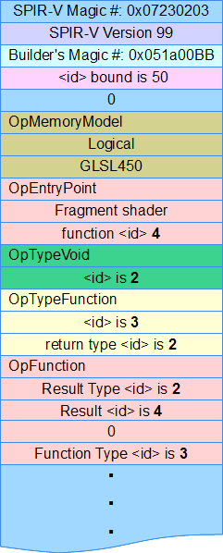



SPIR-V Ecosystem
GLSL
HLSL
SPIR-V
Khronos defined cross-API IR
Native graphics and parallel compute
Easily parsed/extended 32-bit stream
Data object/control flow retained for effective code generation/translation
Open source
tools and translators
Third party kernel and shader languages
glslang
DXC
https://github.com/KhronosGroup/SPIRV-Tools
MSL
OpenCL C Front-end
OpenCL C++ Front-end
SYCL Front-end
HLSL
SPIRV-Cross
GLSL
SPIR-V (Dis)Assembler
SPIR-V Validator
LLVM
LLVM to SPIR-V Bi-directional Translators
Khronos liaising with Clang/LLVM Community E.g. discussing SPIR-V as supported Clang target
SPIRV-opt | SPIRV-remap
SPIR-V Optimizations
Inlining (exhaustive)
Store/Load Elimination
Dead Code Elimination
Dead Branch Elimination
Common Uniform Elimination
Loop Unrolling and Constant Folding
Common Subexpression Elimination
Additional Intermediate Forms
SPIR-V 1.3 released with Vulkan 1.1
inc. subgroups
IHV Driver Runtimes

Slide 15
State of the OpenCL Nation
OpenCL is needed by the industry and widely used
Unique framework for portable heterogenous programming
Growing interest in SYCL, SPIR-V and related tools
Significant work in OpenCL 2.2 maintenance release - here at IWOCL!
Focus on Increasing Deployment Flexibility
Enable conformant OpenCL on more diverse processors and platforms
Streamline delivery of OpenCL in safety critical systems
Enable OpenCL code to run on additional run-times
BUT OpenCL Faces Deployment Friction
OpenCL 1.2 remains the widely adopted baseline – slower adoption of 2.X
Vital platforms such as Android do not have official OpenCL
Many embedded processors are locked out from OpenCL conformance

Slide 16

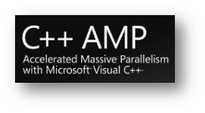


OpenCL Ecosystem Roadmap
Work with industry to bring Heterogeneous compute to standard ISO C++
Single source C++ programming.
Great for supporting C++ apps, libraries and frameworks
SYCL 1.2
C++11 Single source programming
SYCL 1.2.1
C++11 Single source programming
OpenCL ‘Next’
Flexible and efficient deployment of parallel computation across diverse processor architectures
2011
2015
2017
OpenCL 1.2
OpenCL C Kernel Language
OpenCL 2.1 SPIR-V in Core
OpenCL 2.2 C++ Kernel Language
More deployment options: Enabling dispatch of OpenCL C kernels from Vulkan runtimes

Slide 17
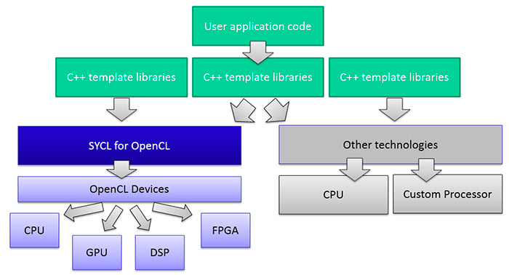

SYCL Ecosystem
Single-source heterogeneous programming using STANDARD C++
Use C++ templates and lambda functions for host & device code
Layered over OpenCL
Fast and powerful path for bring C++ apps and libraries to OpenCL
C++ Kernel Fusion - better performance on complex software than hand-coding
SYCLBLAS, SYCL Eigen, SYCL TensorFlow, SYCL DNN, SYCL GTX, VisionCpp
Close cooperation with ISO C++
C++17 Parallel STL hosted by Khronos
C++20 Parallel STL with Ranges
Implementations
triSYCL, ComputeCpp, ComputeCpp SDK …
More information at http://sycl.tech

Slide 18
SYCL Roadmap
SYCL 1.2.1 Ratified
CTS and Adopters package in progress
SYCL 2.2 Provisional Released
Launched in parallel with OpenCL 2.2 to enable device capabilities from a single source file C++
Shared virtual memory, generic pointers and device-side enqueue etc.
Vehicle to align with C++20 and beyond
Roadmap
Tighter ISO C++ alignment parallel - injecting our heterogeneous knowledge into ISO
More regular releases ~aiming at 1.5 years per release
Will use SYCLxxxx naming convention where xxxx=year of ratification
Focus on Machine learning and Vision processing
For self-driving cars, SYCL TensorFlow, SYCL DNN
SYCL Safety Critical
Demanded by Embedded Market customers
Especially Advanced Driver Assist Systems (ADAS)
Developer Choice
The development of the two specifications are aligned so code can be easily shared between the two approaches
C++ Kernel Language Low Level Control
‘GPGPU’-style separation of device-side kernel source code and host code
Single-source C++
Programmer Familiarity
Approach also taken by C++ AMP and OpenMP

Slide 19
OpenCL Ecosystem Roadmap
Work with industry to bring Heterogeneous compute to standard ISO C++
Single source C++ programming.
Great for supporting C++ apps, libraries and frameworks
SYCL 1.2
C++11 Single source programming
SYCL 1.2.1
C++14 Single source programming
OpenCL ‘Next’
Flexible and efficient deployment of parallel computation across diverse processor architectures
2011
2015
2017
OpenCL 1.2
OpenCL C Kernel Language
OpenCL 2.1 SPIR-V in Core
OpenCL 2.2 C++ Kernel Language
More deployment options: Enabling dispatch of OpenCL C kernels from Vulkan runtimes

Slide 20
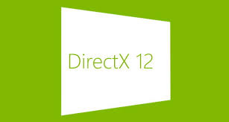

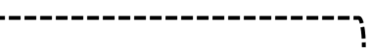





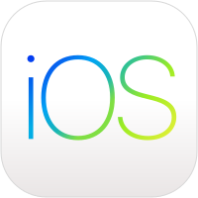
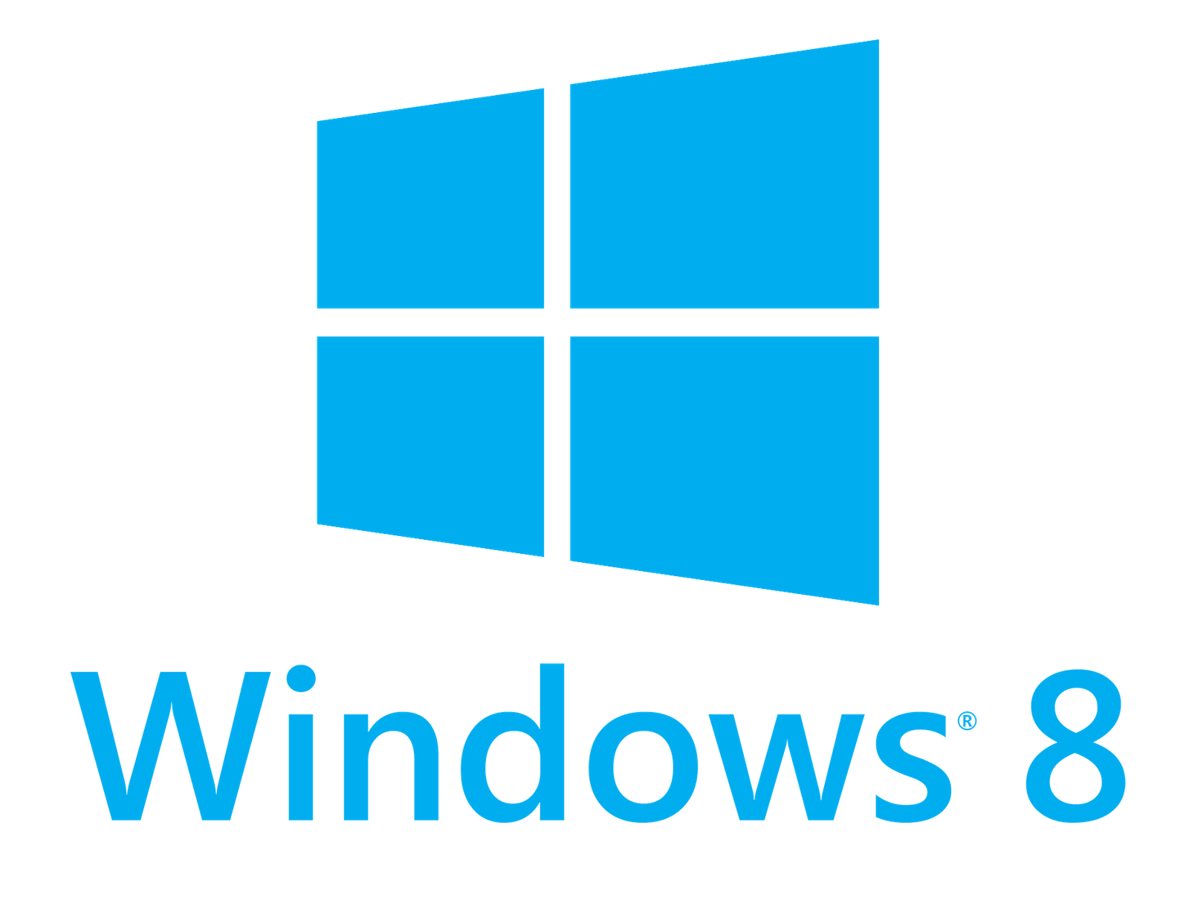
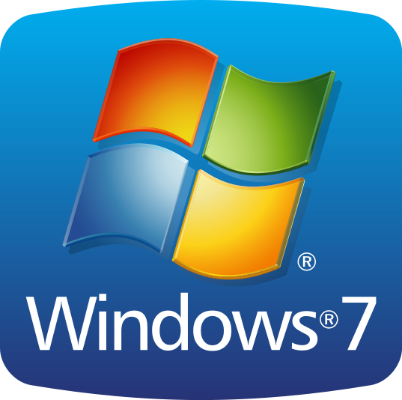


Vulkan and New Generation GPU APIs
Non-proprietary, royalty-free open standard ‘By the industry for the industry’
Portable across multiple platforms - desktop and mobile
Modern architecture | Low overhead| Multi-thread friendly
EXPLICIT GPU access for EFFICIENT, LOW-LATENCY, PREDICTABLE performance
Vulkan Porting Tools
Vulkan is available on Android 7.0+

Slide 21


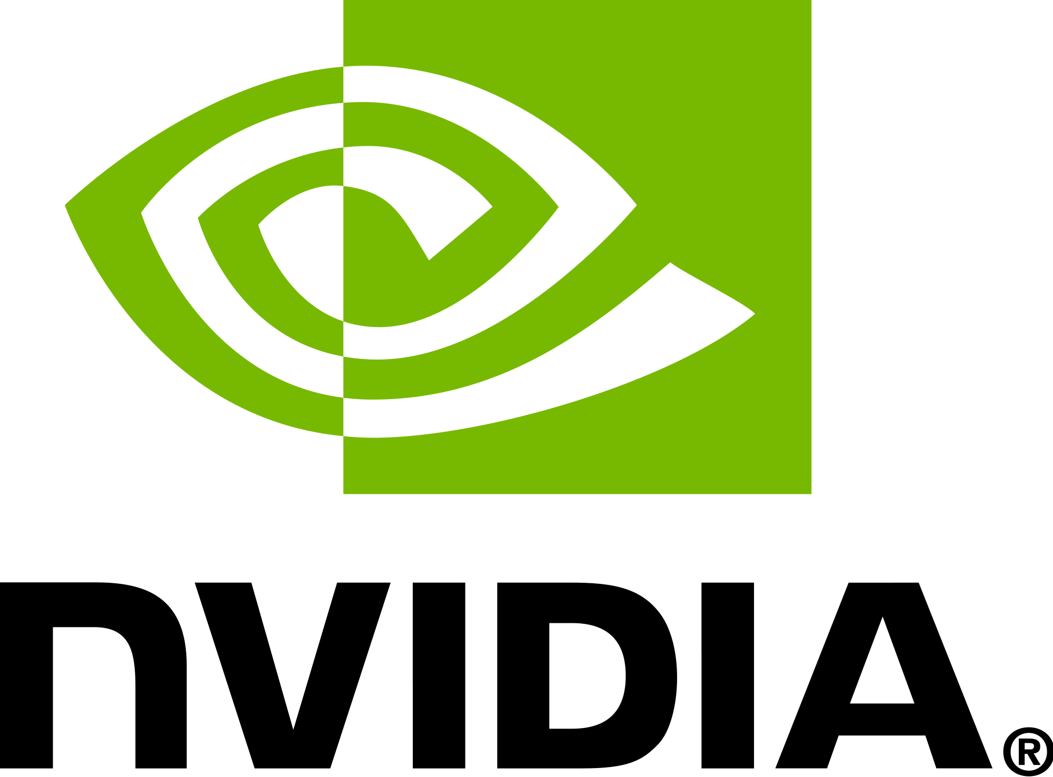





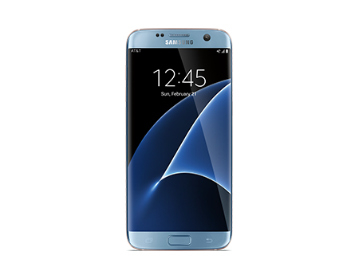

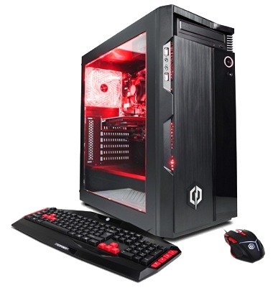

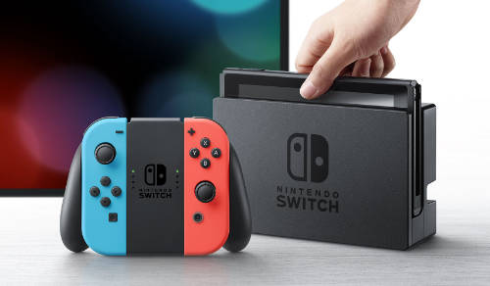

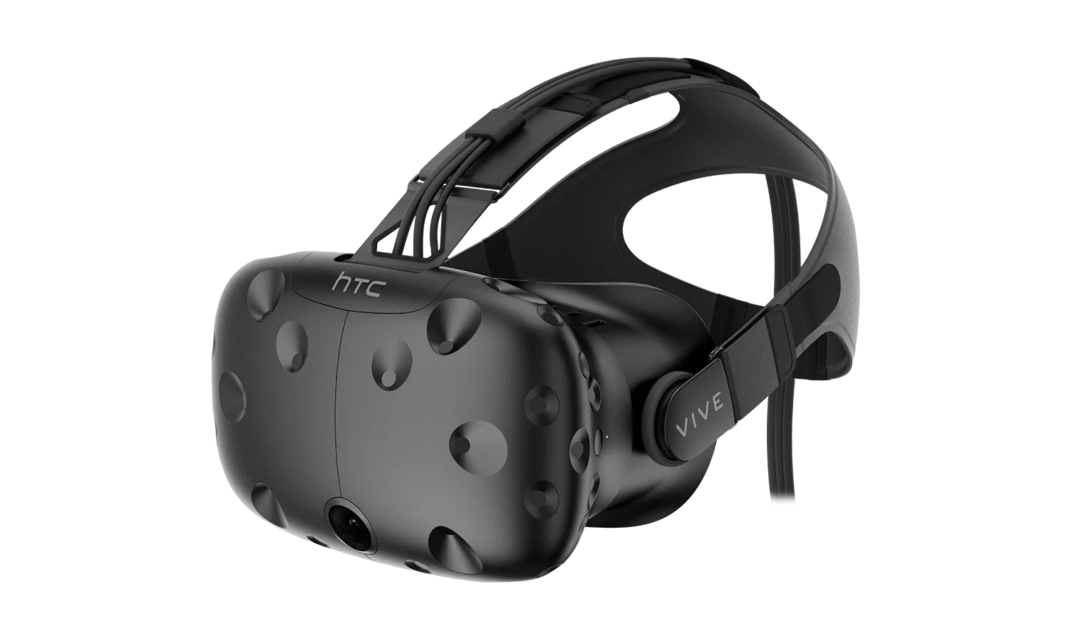
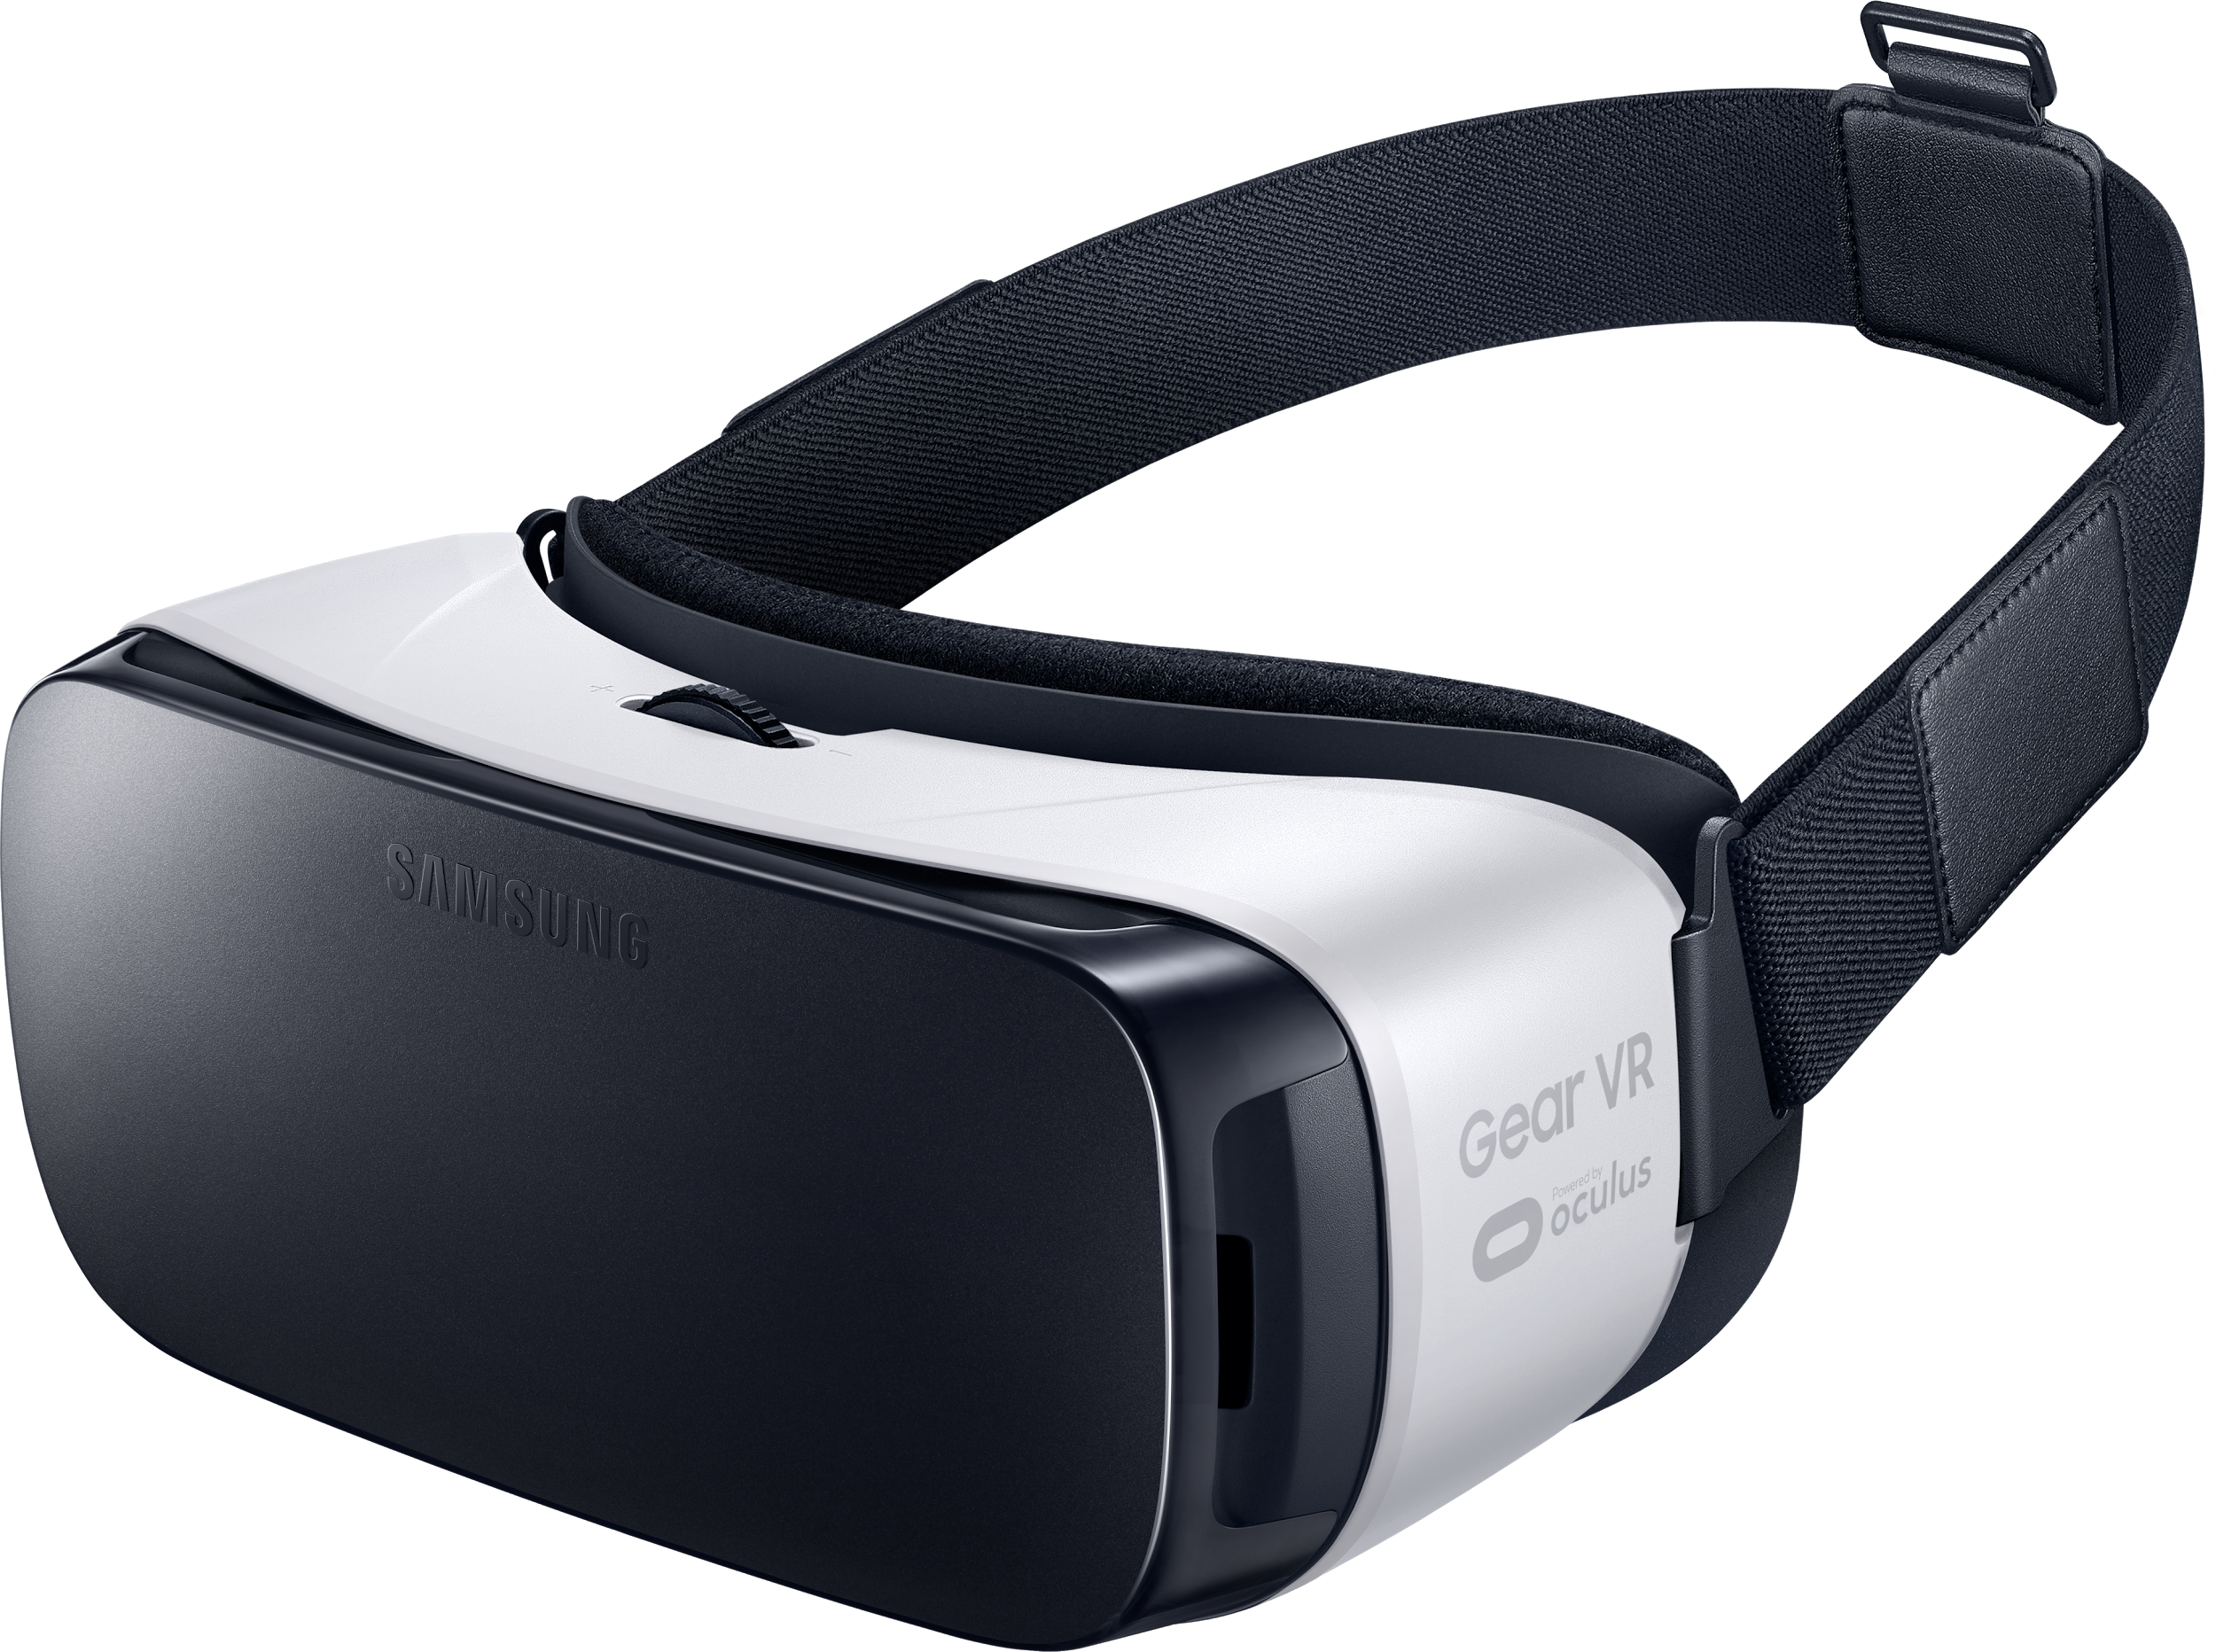
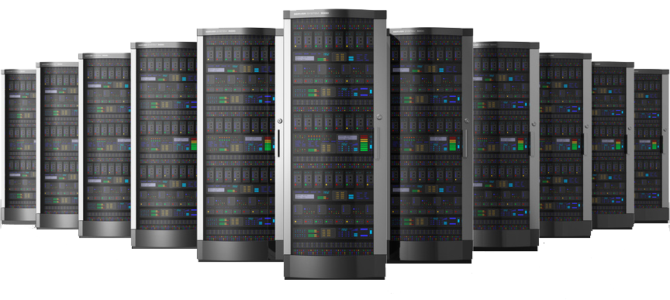
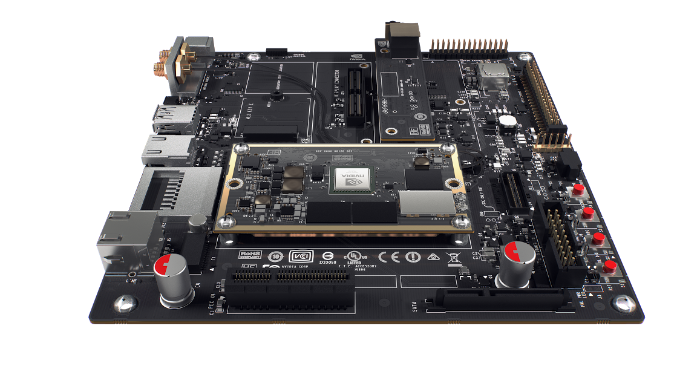







Pervasive Vulkan 1.0
Major GPU Companies supporting Vulkan for Desktop and Mobile Platforms
http://vulkan.gpuinfo.org/
Platforms
Consoles
Desktop
Mobile (Android 7.0+)
Media Players
Virtual Reality
Cloud Services
Embedded
Game Engines
Croteam Serious Engine

Slide 22


Vulkan 1.1 Launch and Ongoing Momentum
Strengthening the Ecosystem
Improved developer tools (SDK, validation/debug layers)
More rigorous conformance testing
Shader toolchain improvements (size, speed, robustness)
Shading language flexibility – HLSL and OpenCL C support
Vulkan Public Ecosystem Forum
Vulkan 1.0 Extensions
Maintenance updates plus additional functionality
Explicit Building Blocks for VR
Explicit Building Blocks for Homogeneous Multi-GPU
Enhanced Windows System Integration
Increased Shading Language Flexibility
Enhanced Cross-Process and Cross-API Sharing
Building Vulkan’s Future
Deliver complete ecosystem – not just specs
Listen and prioritize developer needs
Drive GPU technology
February 2016
Vulkan 1.0
March 2018
Vulkan 1.1
Explicit Access to GPU Acceleration
Integration of Proven and New Technology into Core
Vulkan 1.1 specification launched March 7th with open source conformance tests and tools, and multiple vendor implementations!
Widening Platform Support
Pervasive GPU vendor driver availability
Port Vulkan apps to macOS/iOS and DX12
Open source drivers

Slide 23


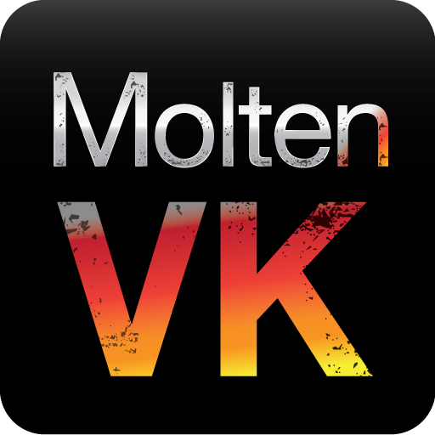
Bringing Vulkan 1.0 Apps to Apple Platforms
Applications
Dota 2 running on Mac up to 50% faster than native OpenGL
Open source SDK to build, run, and debug applications on macOS including validation layer support
Efficiently map a subset of Vulkan over Metal
Very little functionality not supported today:
Triangle fans, Separate stencil reference masks
Vulkan Events, Allocation callbacks
Some texture-specific swizzles
Vulkan macOS SDK
SPIRV-Cross
Convert SPIR-V shaders to platform source formats
macOS / iOS Run-time
Maps Vulkan to Metal
Beta release – but working to pass all applicable conformance tests
Previously a paid product
Now released into OPEN SOURCE
Completely free to use - no fees or royalties – including commercial applications
MoltenVK for macOS and iOS
For macOS 10.11, iOS 9.0 and up

Slide 24


Wider Vulkan Portability Initiative
Widened Platform Support
Open source run-times over additional backends e.g. consoles and Windows UWP
E.g. Mozilla helping to drive gfx-rs for Vulkan over DX12, OpenGL and Metal
https://github.com/gfx-rs/gfx
https://github.com/gfx-rs/portability
Free open source layers and SDKs for apps to be ported to Vulkan-subset layered libraries
Layers
Simulation and validation
JSON Schema defines missing functionality per implementation
TODAY
Beta release to bring Vulkan 1.0 applications to macOS and iOS running over Metal
Conformance Testing
Subsets cannot be conformant but functionality that is present must work!
Portability Extension
Query target capabilities
Notes:
Detailed bullet lists to be edited

Slide 25


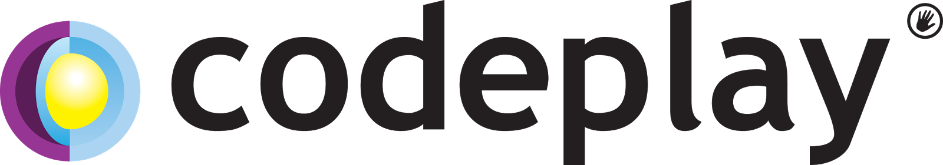
Clspv OpenCL C to Vulkan Compiler
Experimental collaboration between Google, Codeplay, and Adobe
Successfully tested on over 200K lines of Adobe OpenCL C production code
Open source - tracks top-of-tree LLVM and clang, not a fork
Compiles OpenCL C to Vulkan’s SPIR-V execution environment
Proof-of-concept that OpenCL kernels can be brought seamlessly to Vulkan
Significant parts OpenCL C 1.2 so far – shaped by submitted workloads
OpenCL C Source
OpenCL Host Code
Prototype open source project
https://github.com/google/clspv
Clspv
Compiler
Run-time
API Translator
Possible future project – if interest?
Runtime
Increasing deployment options for OpenCL kernel developers e.g. Vulkan is a supported API on Android

Slide 26

Clspv Project Next Steps
Clspv Refinement Process
Compiler is being shaped by the workloads attempted
Vulkan is already expanding its compute model
e.g. 16-bit storage, Variable Pointers, Subgroups
Compact memory types and operations coming
We want developers to try their own kernels
Report porting issues and poor performance
Establishing public kernel repository
Welcome upload of kernels with key operations
Will be used in long-term perf/regression testing
Do we need OpenCL to Vulkan API shim?
Khronos can host an open source project
Possible domains to explore:
Existing OpenCL applications and libraries
Vision processing pipelines
Power-efficient machine learning and inferencing
Even gaming can benefit from better compute
Try using Clspv to port OpenCL kernels to Vulkan compute shaders
Can Clspv successfully map OpenCL C to Vulkan SPIR-V?
Update compiler open source if necessary
Propose/support updates to underlying Vulkan programming model

Slide 27
OpenCL Ecosystem Roadmap
Work with industry to bring Heterogeneous compute to standard ISO C++
Single source C++ programming.
Great for supporting C++ apps, libraries and frameworks
SYCL 1.2
C++11 Single source programming
SYCL 1.2.1
C++14 Single source programming
OpenCL ‘Next’
Flexible and efficient deployment of parallel computation across diverse processor architectures
2011
2015
2017
OpenCL 1.2
OpenCL C Kernel Language
OpenCL 2.1 SPIR-V in Core
OpenCL 2.2 C++ Kernel Language
More deployment options: Enabling dispatch of OpenCL C kernels from Vulkan runtimes

Slide 28
Embedded Processors & OpenCL Conformance
The embedded market is a new frontier needing advanced compute
E.g. Vision and inferencing using a wide range of processor architectures
BUT OpenCL is currently monolithic – and arguably desktop/HPC-centric
E.g. a processor without 32-bit IEEE floating point cannot realistically be conformant
Vendors and developers do not want software emulation of higher precisions
Many functionality requirements change between different markets and processors
Supported Precisions | DSP A | DSP B | DSP C
8-bit integer
16-bit integer
32-bit integer
64-bit intger
16-bit float
32-bit float
64-bit float
Possible to be OpenCL Compliant? | No | No | Yes
OpenCL is disenfranchising one of its most important emerging market opportunities!

Slide 29
OpenCL Next Goals and Design Philosophy
Goals
Enable Conformant OpenCL implementations on more diverse processors and platforms
Enable vendors to ship functionality precisely targeting their customers and markets
A conformant OpenCL can expose precisely what is available in the hardware
Enable incremental feature adoption
Design Philosophy
More OpenCL features become optional for enhanced deployment flexibility
Features can become optional in both API and languages e.g. floating point precisions
Enhanced query mechanisms – precisely which features are supported by a device?
OpenCL Next aims to be a flexible run-time framework that can be pervasively and cost-effectively deployed across a wider range of heterogenous devices

Slide 30
OpenCL Next Feature Sets
Vendors can support ANY combination of features to suit their hardware/market
If all exposed features are conformant – the implementation is conformant
Khronos will define Feature Sets equivalent to current profiles
Existing profiles and device types not going away! No changes to existing applications
No reason for vendors to remove functionality – as that would break applications
Opportunity to coalesce industry support around market-focused feature sets
Khronos aiming to provide Feature Set infrastructure for the industry to leverage
OpenCL 2.2 Functionality
= queryable, optional feature
Industry-defined Feature Set
Khronos-defined OpenCL 2.2 Full Profile Feature Set
Khronos-defined
OpenCL 1.2 Full Profile Feature Set

Slide 31
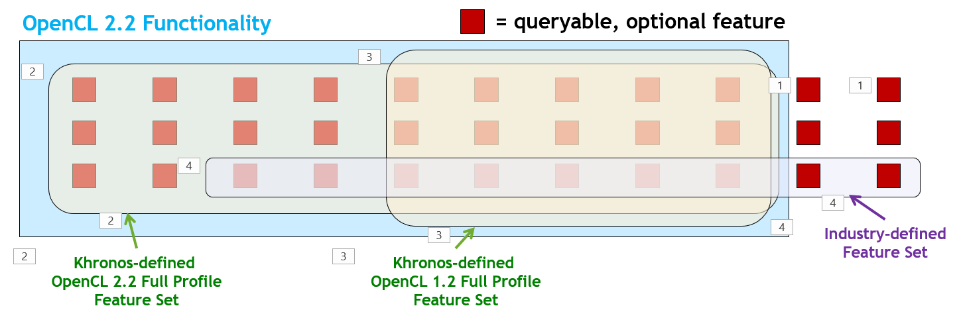
OpenCL Next Feature Set Discussion
We need your input!
Brainstorm discussions below!
Industry-defined Feature Sets to reduce market fragmentation
Who should define these – how reach consensus? Not Khronos?
Vertical market focused – e.g. inferencing, vision processing?
Opportunity to move past the current 1.2 logjam - OpenCL 1.2++ Desktop Feature Set?
Feature Set Conformance - providing an incentive to reduce fragmentation
If 100% of features pass all tests – vendor can claim conformance to that Feature Set
Supporting popular Feature Sets may help drive sales
An implementation may support multiple Feature Sets

Slide 32
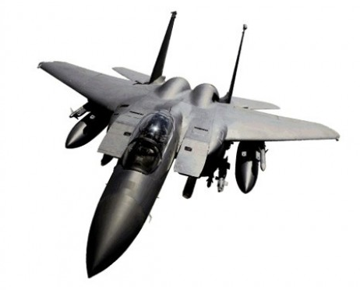
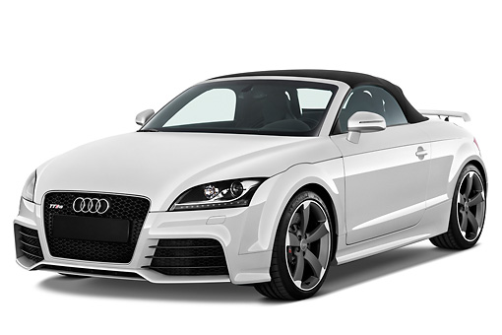
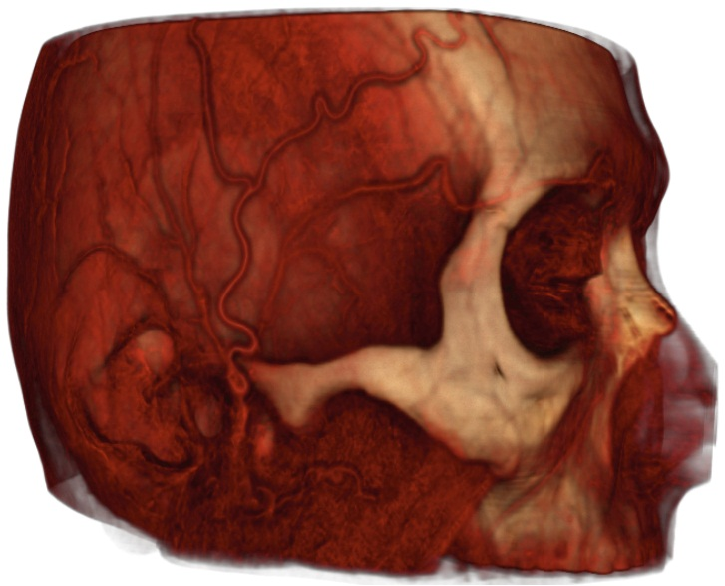
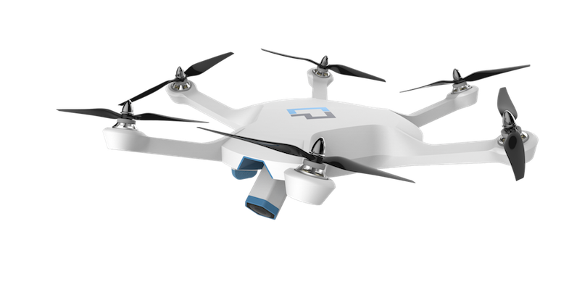
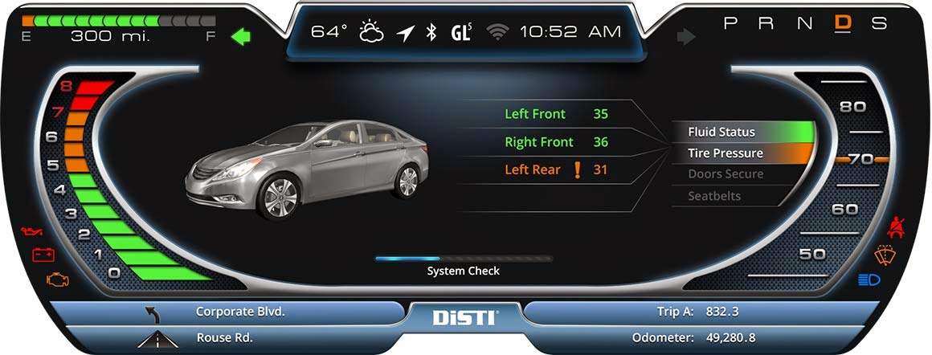
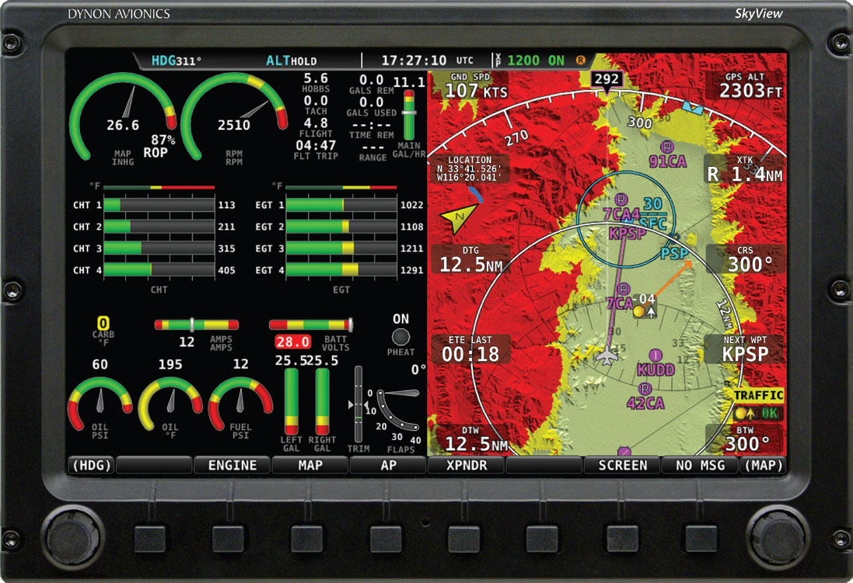
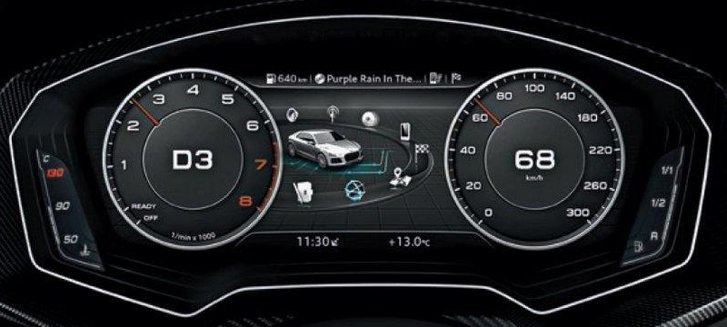

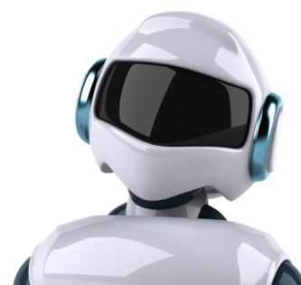




Safety Critical APIs – Khronos Experience
Need for new-generation APIs for safety certifiable vision, graphics and compute
e.g. ISO 26262 and DO-178B/C
OpenGL SC 1.0 - 2005
Fixed function graphics subset
OpenGL SC 2.0 - April 2016
Shader programmable pipeline subset
OpenGL ES 1.0 - 2003
Fixed function graphics
OpenGL ES 2.0 - 2007
Shader programmable pipeline
General lack of industry consensus on how APIs should be designed to streamline safety certification
OpenVX SC 1.1 - May 2017
Restricted “deployment” implementation only executes pre-compiled binary format
Generate guidelines for designing safety critical APIs to ease system certification.
Open to Khronos members AND industry experts

Slide 33
Khronos Safety Critical Advisory Forum
Khronos SC Activities
Industry outreach and cooperation
OpenCL SC TSG
Working on OpenCL SC
Gathering requirements
AESIN
Automotive ADAS & AV + security
https://aesin.org.uk
Generating guidelines for designing safety critical APIs to ease system certification.
Open to Khronos member AND industry experts
https://www.khronos.org/advisors/kscaf
SYCL SC
Guidelines to augment Industry First Safe and Secure Parallel and Heterogeneous C++
Safe AI for Automotive
MISRA C++
C++ WG23 Programming Vulnerabilities
ISO C Safe and Secure SG
ISO C++ Vulnerabilities Safety Critical SG
We are inviting safety critical experts to join KSCAF!
No cost or work commitment
OpenVX SC 1.1 - May 2017
Restricted “deployment” implementation only executes pre-compiled binary format

Slide 34
Khronos Advisory Panels
Encouraging wider industry participation – particularly application developers
The Working Group invites input and shares draft specifications and other materials with its Advisory Panel
Working Group
Shared Email list and Repositories
Advisory Panel
Members
Companies pay membership Fee
Sign NDA and IP Framework + Membership
Directly participate in working groups
Advisors
Individuals Pay $0
Sign NDA and IP Framework
Provide requirements and feedback to working group
Advisory Panel membership is ‘By Invitation’ and renewed annually.
No ‘minimum workload’ commitment – but we love input and feedback!
Please reach out if you wish to participate!
The OpenCL Advisory Panel covers OpenCL and SYCL
Suggestion to hold an OpenCL Advisory Panel F2F session around IWOCL 2019?

Slide 35
Get Involved!
OpenCL is driving to new levels of deployment flexibility
We need to know what you need from OpenCL
IWOCL is the perfect opportunity to find out!
In particular we need input and direction on OpenCL Next and Feature Sets
Let us know what you think!
Multiple ways to engage and help OpenCL evolve
Join Khronos for a voice and a vote in any of these standards
Or ask about an invite to the OpenCL Advisory Panel
Or ask about joining KSCAF if you are involved in Safety Critical development
Or consider contributing kernels to the Clspv project
Neil Trevett
ntrevett@nvidia.com
@neilt3d
www.khronos.org

